Slide 1
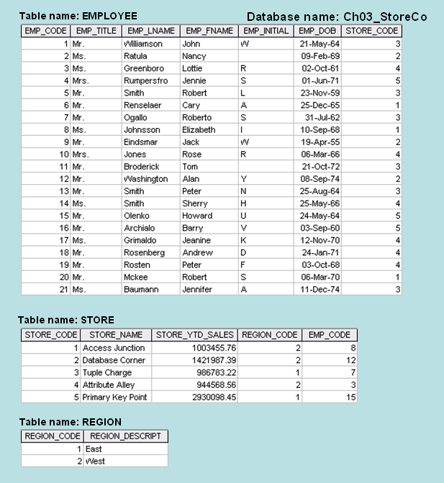
Class Exercise 3 – The Tables

Slide 2
Class Exercise 3 – Solution
1. The Keys
TABLE | PRIMARY KEY | FOREIGN KEY(S)
EMPLOYEE | EMP_CODE | STORE_CODE
STORE | STORE_CODE | REGION_CODE, EMP_CODE
REGION | REGION_CODE | NONE

Slide 3
Class Exercise 3 – Solution
2. The Entity Integrity
TABLE | ENTITY INTEGRITY | EXPLANATION
EMPLOYEE | Yes | Each EMP_CODE value is unique and there are no nulls.
STORE | Yes | Each STORE_CODE value is unique and there are no nulls.
REGION | Yes | Each REGION_CODE value is unique and there are no nulls.

Slide 4
Class Exercise 3 – Solution
2. The Referential Integrity
TABLE | REFERENTIAL INTEGRITY | EXPLANATION
EMPLOYEE | Yes | Each STORE_CODE value in EMPLOYEE points to an existing STORE_CODE value in STORE.
STORE | Yes | Each REGION_CODE value in STORE points to an existing REGION_CODE value in REGION and each EMP_CODE value in STORE points to an existing EMP_CODE value in EMPLOYEE.
REGION | NA

